Slide 1
CBDB office codes revision
201805007

Slide 2
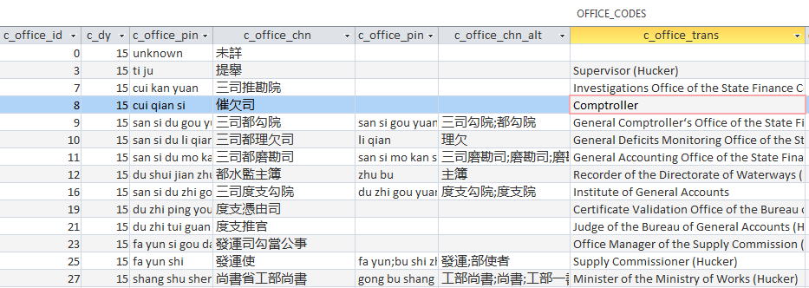
Currently there is one OFFICE_CODES table in CBDB ACCESS
OFFICE_CODES are arranged by dynasty (c_dy)

Slide 3
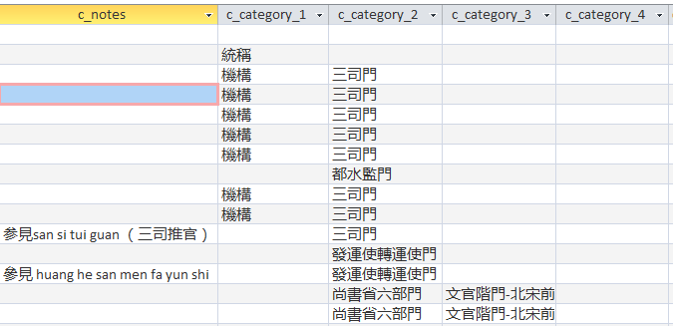
It includes notes and 4 levels of administrative units to which an official title belongs

Slide 4
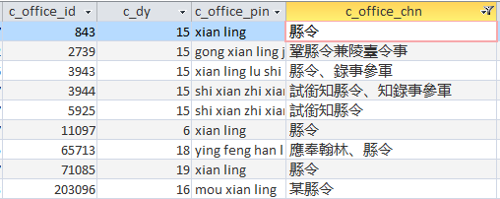
OFFICE_CODES are arranged by dynasty (c_dy). Thus a 縣令 in Song has one code and a 縣令 in Ming has a different code.

Slide 5
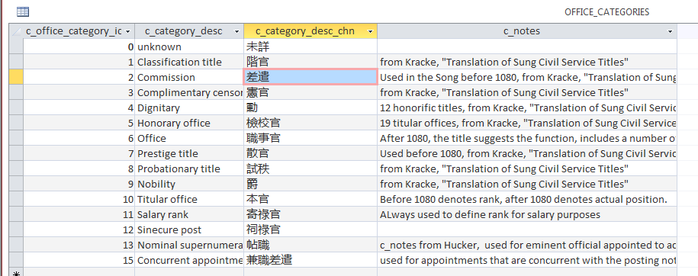
related tables: Office_Categories

Slide 6
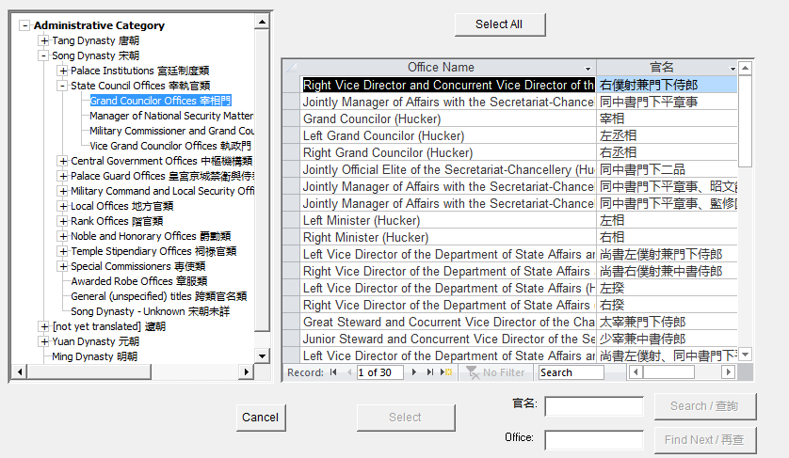
In order to select offices for queries we need a “tree” structure

Slide 7
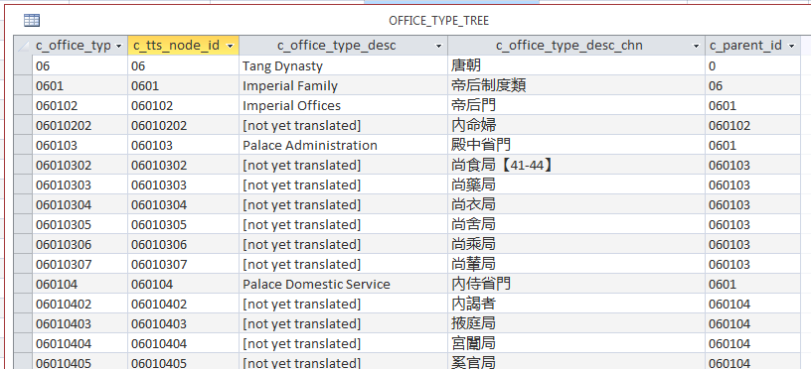
The Office_Type_Tree table does this by showing what something “belongs to”

Slide 8
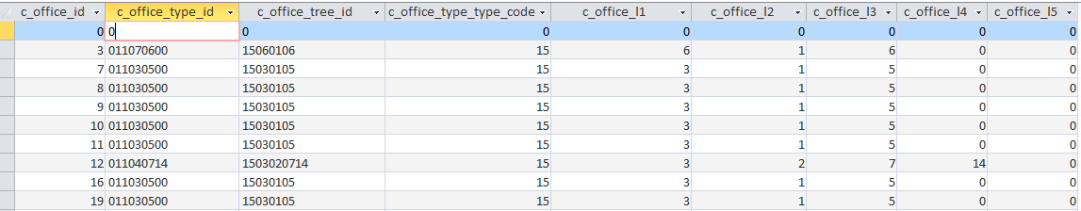
OFFICE_CODE_TYPE_REL give the relationship of specific offices to the office hierarchy
It allows for up to 5 levels of administrative hierarchy, more levels can be added

Slide 9
We are proposing to revise this approach.
-- an office title (e.g. 縣令 or 員外郎) should have one code for all dynasties
-- one office title belongs to at least one administrative unit (that unit may be the dynasty)
-- but one office title may belong to many different administrative units (e.g.員外郎)
-- The person who has an office title does so in time and space, but this is handled separated.

Slide 10
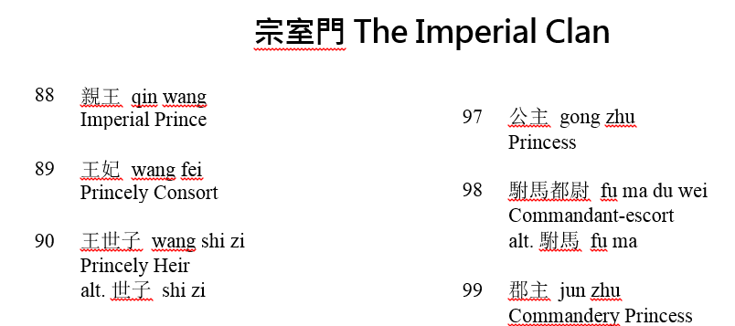
Why we are beginning with the Ming dynasty.
明代職官中英辭典
Chinese-English Dictionary of Ming Government Official Titles
By 張 穎Ying Zhang, 薛 燕Susan Xue,薛昭慧Zhaohui Xue, 倪 莉Li Ni

Slide 11
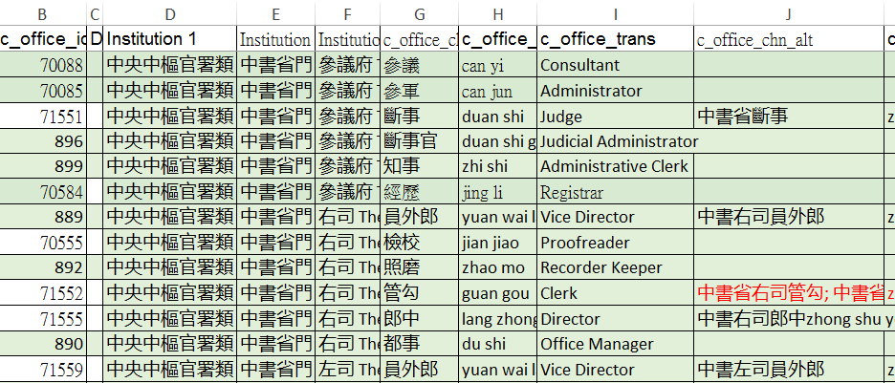
They have provided us with an Excel sheet showing the hierarchy and giving CBDB codes (7XXXX) or Dictionary codes (1-3238)

Slide 12
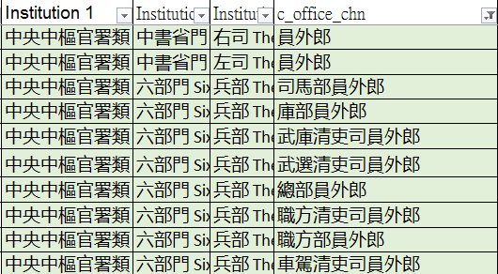
The problem: The Dictionary only used 3 administrative levels above the official title. This is not enough.

Slide 13
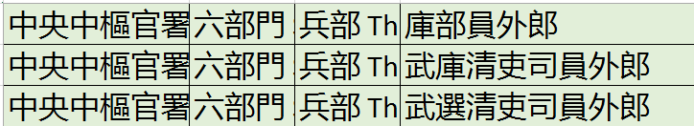
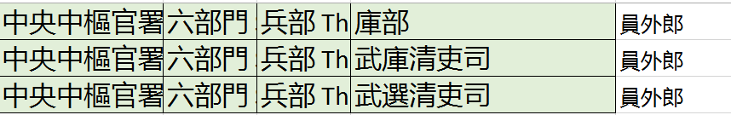
The task
Extract the lowest level office title
Create more administrative levels
Becomes
There are efficient ways of doing this in Excel

Slide 14
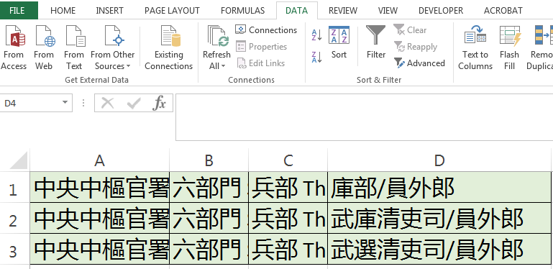
There are efficient ways of doing this in Excel

Slide 15
However, this is not always so straightforward.
萬全都指揮使司都指揮僉事
萬全都指揮使司都指揮使
萬全都司都指揮同知

Slide 16
Check the datasheet for examples of usage or the Dictionary
指揮使司僉事
都司掌印都指揮僉事
衛管衛事都督僉事
撫治道僉事
指揮僉事
試僉事
宣慰使司僉事

Slide 17
Appointment types are not part of an official title
In this data appointment types are generally not an issue. For a list see CBDB Access APPOINTMENT_TYPE_CODES
We regard 兼 and the prefixes 行、行在、試 etc. as appointment types. They are coded separately.
Thus 試僉事 is treated as 僉事

Slide 18
Merged Ming Government Official Table 4 CBDB 2018-04-30_PKB_working

